Slide 1

Introduction To Object-Oriented Programming
Chapter 13 – Aliens!

Slide 2
Aliens!
In this chapter, we’ll add aliens to AlienInvasion. We’ll add one alien near the top of the screen and then generate a whole fleet of aliens. We’ll make the fleet advance sideways and down, and we’ll get rid of any aliens hit by a bullet.
Finally, we’ll limit the number of ships a player has and end the game when the player runs out of ships.

Slide 3
Reviewing the Project
In this chapter, we’ll do the following:
Add a single alien to the top-left corner of the screen, with appropriate spacing around it.
Fill the upper portion of the screen with as many aliens as we can fit horizontally. We’ll then create additional rows of aliens until we have a full fleet.
Make the fleet move sideways and down until the entire fleet is shot down, an alien hits the ship, or an alien reaches the ground. If the entire fleet is shot down, we’ll create a new fleet. If an alien hits the ship or the ground, we’ll destroy the ship and create a new fleet.
Limit the number of ships the player can use, and end the game when the player has used up the allotted number of ships.

Slide 4
Creating the First Alien
Placing one alien on the screen is like placing a ship on the screen. Each alien’s behavior is controlled by a class called Alien, which we’ll structure like the Ship class.
Make sure you save the image file you choose in the images folder

Slide 5
Creating the Alien Class
Now we’ll write the Alien class and save it as alien.py
Most of this class is like the Ship class, except for the alien’s placement on the screen. We initially place each alien near the top-left corner of the screen; we add a space to the left of it that’s equal to the alien’s width and a space above it equal to its height, so it’s easy to see. We’re mainly concerned with the aliens’ horizontal speed, so we’ll track the horizontal position of each alien precisely.
This Alien class doesn’t need a method for drawing it to the screen; instead, we’ll use a Pygame group method that automatically draws all the elements of a group to the screen

Slide 6
Creating an Instance of the Alien
We want to create an instance of Alien so we can see the first alien on the screen. Because it’s part of our setup work, we’ll add the code for this instance at the end of the __init__() method in AlienInvasion. Eventually, we’ll create an entire fleet of aliens, which will be quite a bit of work, so we’ll make a new helper method called _create_fleet().
The order of methods in a class doesn’t matter, as long as there’s some consistency to how they’re placed. I’ll place _create_fleet() just before the _update_screen() method, but anywhere in AlienInvasion will work. First, we’ll import the Alien class.

Slide 7
Creating an Instance of the Alien
We create a group to hold the fleet of aliens, and we call _create_fleet(). In this method, we’re creating one instance of Alien and then adding it to the group that will hold the fleet. The alien will be placed in the default upper-left area of the screen.
To make the alien appear, we need to call the group’s draw() method in _update_screen(). When you call draw() on a group, Pygame draws each element in the group at the position defined by its rect attribute. The draw() method requires one argument: a surface on which to draw the elements from the group.

Slide 8
Building the Alien Fleet
To draw a fleet, we need to figure out how to fill the upper portion of the screen with aliens, without overcrowding the game window. There are a number of ways to accomplish this goal.
We’ll approach it by adding aliens across the top of the screen, until there’s no space left for a new alien. Then we’ll repeat this process, as long as we have enough vertical space to add a new row.

Slide 9
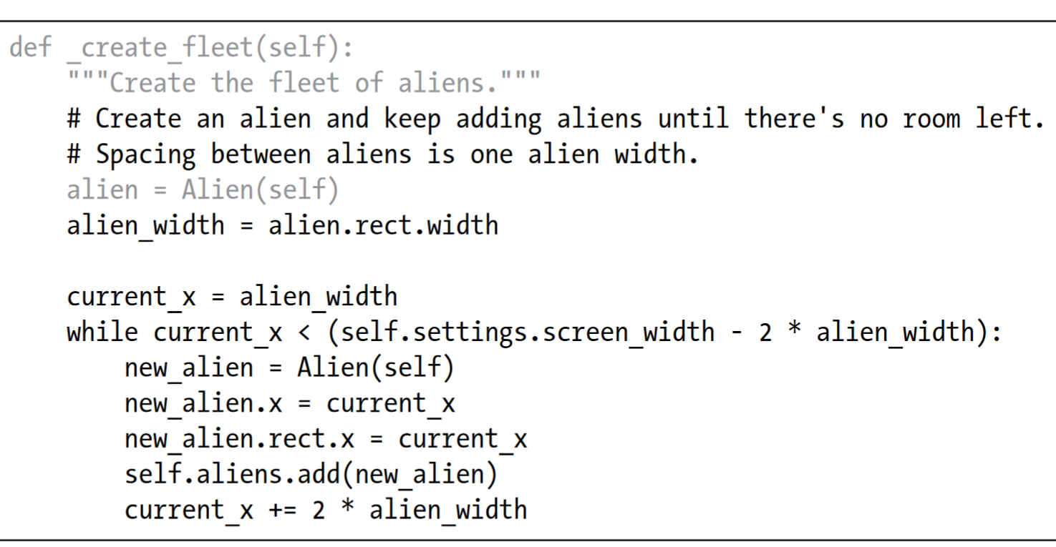
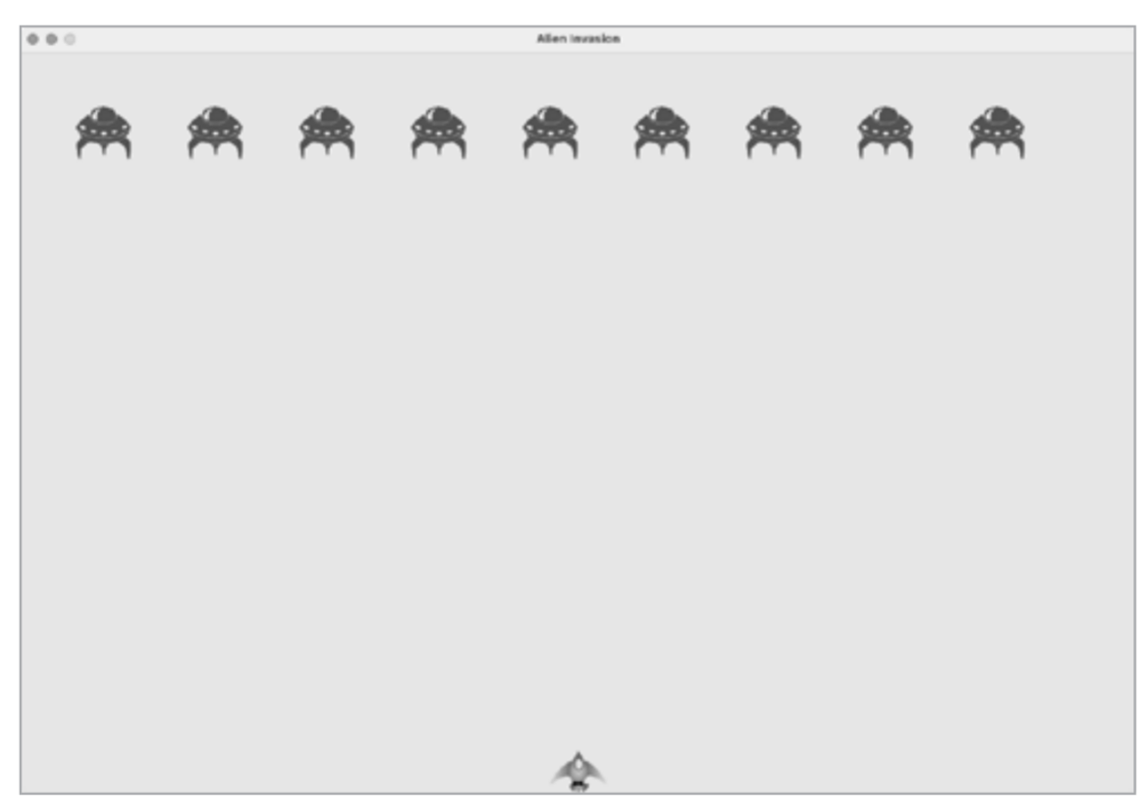
Creating a Row of Aliens
Now we’re ready to generate a full row of aliens. To make a full row, we’ll first make a single alien so we have access to the alien’s width.
We’ll place an alien on the left side of the screen and then keep adding aliens ntil we run out of space

Slide 10
Creating a Row of Aliens
We get the alien’s width from the first alien we created, and then define a variable called current_x. This refers to the horizontal position of the next alien we intend to place on the screen. We initially set this to one alien width, to offset the first alien in the fleet from the left edge of the screen.
Next, we begin the while loop; we’re going to keep adding aliens while there’s enough room to place one. To determine whether there’s room to place another alien, we’ll compare current_x to some maximum value.

Slide 11
Creating a Row of Aliens
As long as there’s at least two alien widths’ worth of space at the right edge of the screen, we enter the loop and add another alien to the fleet.
Whenever there’s enough horizontal space to continue the loop, we want to do two things: create an alien at the correct position, and define the horizontal position of the next alien in the row. We create an alien and assign it to new_alien. Then we set the precise horizontal position to the current value of current_x. We also position the alien’s rect at this same x-value, and add the new alien to the group self.aliens.

Slide 12
Creating a Row of Aliens
Finally, we increment the value of current_x. We add two alien widths to the horizontal position, to move past the alien we just added and to leave some space between the aliens as well. Python will re-evaluate the condition at the start of the while loop and decide if there’s room for another alien.
When there’s no room left, the loop will end, and we should have a full row of aliens. When you run Alien Invasion now, you should see the first row of aliens appear

Slide 13
Refactoring _create_fleet()
If the code we’ve written so far was all we needed to create a fleet, we’d probably leave _create_fleet() as is. But we have more work to do, so let’s clean up the method a bit. We’ll add a new helper method, _create_alien(), and call it from _create_fleet()
The method _create_alien() requires one parameter in addition to self: the x-value that specifies where the alien should be placed. The code in the body of _create_alien() is the same code that was in _create_fleet(), except we use the parameter name x_position in place of current_x. This refactoring will make it easier to add new rows and create an entire fleet

Slide 14
Adding Rows
To finish the fleet, we’ll keep adding more rows until we run out of room.
We’ll use a nested loop—we’ll wrap another while loop around the current one. The inner loop will place aliens horizontally in a row by focusing on the aliens’ x-values. The outer loop will place aliens vertically by focusing on the y-values. We’ll stop adding rows when we get near the bottom of the screen, leaving enough space for the ship and some room to start firing at the aliens

Slide 15
Adding Rows
We’ll need to know the alien’s height in order to place rows, so we grab the alien’s width and height using the size attribute of an alien rect. A rect’s size attribute is a tuple containing its width and height.
Next, we set the initial x- and y-values for the placement of the first alien in the fleet. We place it one alien width in from the left and one alien height down from the top. Then we define the while loop that controls how many rows are placed onto the screen. As long as the y-value for the next row is less than the screen height, minus three alien heights, we’ll keep adding rows. We call _create_alien(), and pass it the y-value as well as its x-position.

Slide 16
Adding Rows
Notice the indentation of the last two lines of code. They’re inside the outer while loop, but outside the inner while loop. This block runs after the inner loop is finished; it runs once after each row is created.
After each row has been added, we reset the value of current_x so the first alien in the next row will be placed at the same position as the first alien in the previous rows. Then we add two alien heights to the current value of current_y, so the next row will be placed further down the screen.

Slide 17
Making the Fleet Move
Now let’s make the fleet of aliens move to the right across the screen until it hits the edge, and then make it drop a set amount and move in the other direction. We’ll continue this movement until all aliens have been shot down, one collides with the ship, or one reaches the bottom of the screen.
Let’s begin by making the fleet move to the right.

Slide 18
Moving the Aliens Right
To move the aliens, we’ll use an update() method in alien.py, which we’ll call for each alien in the group of aliens.
We create a settings parameter in __init__() so we can access the alien’s speed in update(). Each time we update an alien’s position, we move it to the right by the amount stored in alien_speed. We track the alien’s exact position with the self.x attribute, which can hold float values. We then use the value of self.x to update the position of the alien’s rect

Slide 19
Moving the Aliens Right
In the main while loop, we already have calls to update the ship and bullet positions. Now we’ll add a call to update the position of each alien as well
We’re about to write some code to manage the movement of the fleet, so we create a new method called _update_aliens(). We update the aliens’ positions after the bullets have been updated, because we’ll soon be checking to see whether any bullets hit any aliens.
Where you place this method in the module is not critical. But to keep the code organized, I’ll place it just after _update_bullets() to match the order of method calls in the while loop
We use the update() method on the aliens group, which calls each alien’s update() method. When you run Alien Invasion now, you should see the fleet move right and disappear off the side of the screen

Slide 20
Creating Settings for Fleet Direction
Now we’ll create the settings that will make the fleet move down the screen and to the left when it hits the right edge of the screen.
The setting fleet_drop_speed controls how quickly the fleet drops down the screen each time an alien reaches either edge. It’s helpful to separate this speed from the aliens’ horizontal speed so you can adjust the two speeds independently

Slide 21
Creating Settings for Fleet Direction
To implement the setting fleet_direction, we could use a text value such as 'left' or 'right', but we’d end up with if-elif statements testing for the fleet direction.
Instead, because we only have two directions to deal with, let’s use the values 1 and −1 and switch between them each time the fleet changes direction. (Using numbers also makes sense because moving right involves adding to each alien’s x-coordinate value, and moving left involves subtracting from each alien’s x-coordinate value.)

Slide 22
Checking Whether an Alien Has Hit the Edge
We need a method to check whether an alien is at either edge, and we need to modify update() to allow each alien to move in the appropriate direction
We can call the new method check_edges() on any alien to see whether it’s at the left or right edge. The alien is at the right edge if the right attribute of its rect is greater than or equal to the right attribute of the screen’s rect. It’s at the left edge if its left value is less than or equal to 0.
Rather than put this conditional test in an if block, we put the test directly in the return statement. This method will return True if the alien is at the right or left edge, and False if it is not at either edge

Slide 23
Checking Whether an Alien Has Hit the Edge
We modify the method update() to allow motion to the left or right by multiplying the alien’s speed by the value of fleet_direction.
If fleet_direction is 1, the value of alien_speed will be added to the alien’s current position, moving the alien to the right; if fleet_direction is −1, the value will be subtracted from the alien’s position, moving the alien to the left.

Slide 24
Dropping the Fleet and Changing Direction
When an alien reaches the edge, the entire fleet needs to drop down and change direction. Therefore, we need to add some code to AlienInvasion because that’s where we’ll check whether any aliens are at the left or right edge.
We’ll make this happen by writing the methods _check_fleet_edges() and _change_fleet_direction(), and then modifying _update_aliens().

Slide 25
Dropping the Fleet and Changing Direction
In _check_fleet_edges(), we loop through the fleet and call check_edges() on each alien. If check_edges() returns True, we know an alien is at an edge and the whole fleet needs to change direction; so we call _change_fleet_direction() and break out of the loop.
In _change_fleet_direction(), we loop through all the aliens and drop each one using the setting fleet_drop_speed; then we change the value of fleet_direction by multiplying its current value by −1.
The line that changes the fleet’s direction isn’t part of the for loop. We want to change each alien’s vertical position, but we only want to change the direction of the fleet once.

Slide 26
Dropping the Fleet and Changing Direction
We’ve modified the method by calling _check_fleet_edges() before updating each alien’s position.
When you run the game now, the fleet should move back and forth between the edges of the screen and drop down every time it hits an edge.
Now we can start shooting down aliens and watch for any aliens that hit the ship or reach the bottom of the screen

Slide 27
Shooting Aliens
We’ve built our ship and a fleet of aliens, but when the bullets reach the aliens, they simply pass through because we aren’t checking for collisions.
In game programming, collisions happen when game elements overlap.
To make the bullets shoot down aliens, we’ll use the function sprite.groupcollide() to look for collisions between members of two groups.

Slide 28
Detecting Bullet Collisions
The new code we added compares the positions of all the bullets in self.bullets and all the aliens in self.aliens, and identifies any that overlap.
Whenever the rects of a bullet and alien overlap, groupcollide() adds a key-value pair to the dictionary it returns. The two True arguments tell Pygame to delete the bullets and aliens that have collided.
When you run Alien Invasion now, aliens you hit should disappear.

Slide 29
Making Larger Bullets for Testing
You can test many features of Alien Invasion simply by running the game, but some features are tedious to test in the normal version of the game. For example, it’s a lot of work to shoot down every alien on the screen multiple times to test whether your code responds to an empty fleet correctly.
To test particular features, you can change certain game settings to focus on a particular area. For example, you might shrink the screen so there are fewer aliens to shoot down or increase the bullet speed and give yourself lots of bullets at once.
Try setting bullet_width to 300, or even 3,000, to see how quickly you can shoot down the fleet. Changes like these will help you test the game more efficiently and possibly spark ideas for giving players bonus powers

Slide 30
Repopulating the Fleet
One key feature of Alien Invasion is that the aliens are relentless: every time the fleet is destroyed, a new fleet should appear.
To make a new fleet of aliens appear after a fleet has been destroyed, we first check whether the aliens group is empty. If it is, we make a call to _create_fleet(). We’ll perform this check at the end of _update_bullets(), because that’s where individual aliens are destroyed.

Slide 31
Repopulating the Fleet
We check whether the aliens group is empty. An empty group evaluates to False, so this is a simple way to check whether the group is empty. If it is, we get rid of any existing bullets by using the empty() method, which removes all the remaining sprites from a group.
We also call _create_fleet(), which fills the screen with aliens again. Now a new fleet appears as soon as you destroy the current fleet.

Slide 32
Speeding Up the Bullets
If you’ve tried firing at the aliens in the game’s current state, you might find that the bullets aren’t traveling at the best speed for gameplay. They might be a little too slow or a little too fast. At this point, you can modify the settings to make the gameplay more interesting. Keep in mind that the game is going to get progressively faster, so don’t make the game too fast at the beginning.
We modify the speed of the bullets by adjusting the value of bullet_speed in settings.py

Slide 33
Refactoring _update_bullets()
Let’s refactor _update_bullets() so it’s not doing so many different tasks. We’ll move the code for dealing with bullet-alien collisions to a separate method
We’ve created a new method, _check_bullet_alien_collisions(), to look for collisions between bullets and aliens and to respond appropriately if the entire fleet has been destroyed. Doing so keeps _update_bullets() from growing too long and simplifies further development.

Slide 34
Ending the Game
What’s the fun and challenge in playing a game you can’t lose? If the player doesn’t shoot down the fleet quickly enough, we’ll have the aliens destroy the ship when they make contact.
At the same time, we’ll limit the number of ships a player can use, and we’ll destroy the ship when an alien reaches the bottom of the screen. The game will end when the player has used up all their ships.

Slide 35
Detecting Alien-Ship Collisions
We’ll start by checking for collisions between aliens and the ship so we can respond appropriately when an alien hits it. We’ll check for alien-ship collisions immediately after updating the position of each alien in AlienInvasion
The spritecollideany() function takes two arguments: a sprite and a group. The function looks for any member of the group that has collided with the sprite and stops looping through the group as soon as it finds one member that has collided with the sprite. Here, it loops through the group aliens and returns the first alien it finds that has collided with ship

Slide 36
Detecting Alien-Ship Collisions
If no collisions occur, spritecollideany() returns None and the if block won’t execute. If it finds an alien that has collided with the ship, it returns that alien and the if block executes: it prints Ship hit!!!. When an alien hits the ship, we’ll need to do a number of tasks: delete all remaining aliens and bullets, recenter the ship, and create a new fleet. Before we write code to do all this, we want to know that our approach to detecting alien-ship collisions works correctly. Writing a print() call is a simple way to ensure we’re detecting these collisions properly.
Now when you run Alien Invasion, the message Ship hit!!! should appear in the terminal whenever an alien runs into the ship. When you’re testing this feature, set fleet_drop_speed to a higher value, such as 50 or 100, so the aliens reach your ship faster

Slide 37
Responding to Alien-Ship Collisions
Now we need to figure out exactly what will happen when an alien collides with the ship. Instead of destroying the ship instance and creating a new one, we’ll count how many times the ship has been hit by tracking statistics for the game. Tracking statistics will also be useful for scoring.
Let’s write a new class, GameStats, to track game statistics, and let’s save it as game_stats.py

Slide 38
Responding to Alien-Ship Collisions
We’ll make one GameStats instance for the entire time Alien Invasion is running, but we’ll need to reset some statistics each time the player starts a new game. To do this, we’ll initialize most of the statistics in the reset_stats() method, instead of directly in __init__(). We’ll call this method from __init__() so the statistics are set properly when the GameStats instance is first created.
But we’ll also be able to call reset_stats() anytime the player starts a new game. Right now we have only one statistic, ships_left, the value of which will change throughout the game.

Slide 39
Responding to Alien-Ship Collisions
We also need to make a few changes in alien_invasion.py to create an instance of GameStats. First, we’ll update the import statements at the top of the file.
We import the sleep() function from the time module in the Python standard library, so we can pause the game for a moment when the ship is hit. We also import GameStats.

Slide 40
Responding to Alien-Ship Collisions
We make the instance after creating the game window but before defining other game elements, such as the ship.
When an alien hits the ship, we’ll subtract 1 from the number of ships left, destroy all existing aliens and bullets, create a new fleet, and reposition the ship in the middle of the screen. We’ll also pause the game for a moment so the player can notice the collision and regroup before a new fleet appears.

Slide 41
Responding to Alien-Ship Collisions
Let’s put most of this code in a new method called _ship_hit(). We’ll call this method from _update_aliens() when an alien hits the ship
The new method _ship_hit() coordinates the response when an alien hits a ship. Inside _ship_hit(), the number of ships left is reduced by 1, after which we empty the groups bullets and aliens.

Slide 42
Responding to Alien-Ship Collisions
Next, we create a new fleet and center the ship. Then we add a pause after the updates have been made to all the game elements but before any changes have been drawn to the screen, so the player can see that their ship has been hit.
The sleep() call pauses program execution for half a second, long enough for the player to see that the alien has hit the ship. When the sleep() function ends, code execution moves on to the _update_screen() method, which draws the new fleet to the screen.

Slide 43
Responding to Alien-Ship Collisions
In _update_aliens(), we replace the print() call with a call to _ship_hit() when an alien hits the ship
We center the ship the same way we did in __init__(). After centering it, we reset the self.x attribute, which allows us to track the ship’s exact position
Run the game, shoot a few aliens, and let an alien hit the ship. The game should pause, and a new fleet should appear with the ship centered at the bottom of the screen again

Slide 44
Aliens That Reach the Bottom of the Screen
If an alien reaches the bottom of the screen, we’ll have the game respond the same way it does when an alien hits the ship. To check when this happens, add a new method in alien_invasion.py
The method _check_aliens_bottom() checks whether any aliens have reached the bottom of the screen. An alien reaches the bottom when its rect.bottom value is greater than or equal to the screen’s height. If an alien reaches the bottom, we call _ship_hit(). If one alien hits the bottom, there’s no need to check the rest, so we break out of the loop after calling _ship_hit()

Slide 45
Aliens That Reach the Bottom of the Screen
We call _check_aliens_bottom() after updating the positions of all the aliens and after looking for alien-ship collisions.
Now a new fleet will appear every time the ship is hit by an alien or an alien reaches the bottom of the screen

Slide 46
Game Over!
Alien Invasion feels more complete now, but the game never ends. The value of ships_left just grows increasingly negative.
Let’s add a game_active flag, so we can end the game when the player runs out of ships. We’ll set this flag at the end of the __init__() method in AlienInvasion

Slide 47
Game Over!
Now we add code to _ship_hit() that sets game_active to False when the player has used up all their ships
Most of _ship_hit() is unchanged. We’ve moved all the existing code into an if block, which tests to make sure the player has at least one ship remaining. If so, we create a new fleet, pause, and move on. If the player has no ships left, we set game_active to False

Slide 48
Identifying When Parts of the Game Should Run
We need to identify the parts of the game that should always run and the parts that should run only when the game is active
In the main loop, we always need to call _check_events(), even if the game is inactive. For example, we still need to know if the user presses Q to quit the game or clicks the button to close the window. We also continue updating the screen so we can make changes to the screen while waiting to see whether the player chooses to start a new game. The rest of the function calls need to happen only when the game is active, because when the game is inactive, we don’t need to update the positions of game elements. Now when you play Alien Invasion, the game should freeze when you’ve used up all your ships

Slide 49
Summary
In this chapter, you learned how to add a large number of identical elements to a game by creating a fleet of aliens.
You used nested loops to create a grid of elements, and you made a large set of game elements move by calling each element’s update() method.
You learned to control the direction of objects on the screen and to respond to specific situations, such as when the fleet reaches the edge of the screen.
You detected and responded to collisions when bullets hit aliens and aliens hit the ship.
You also learned how to track statistics in a game and use a game_active flag to determine when the game is over.

